Slide 1
Topic:
Design and Implementation of a Deep Learning Model for Multi-Stock Forecasting and Real-Time Analysis
Project Details
Name: SANYA FEMI ADEJUMO
Student ID: 21pn02/22
Department: Computer Science
Supervisor: Dr Ipeayeda
Defense Date: July 25, 2025
Field: AI & Financial Technology
Notes:
fghjklöä

Slide 2
CONTENT:
Introduction,
Statement of the Problem,
Aim and Objective
Scope of the study
Methodology,
System Implementation/Results and discussion
Conclusion and Recommendation
Reference
Thanks for listening

Slide 3

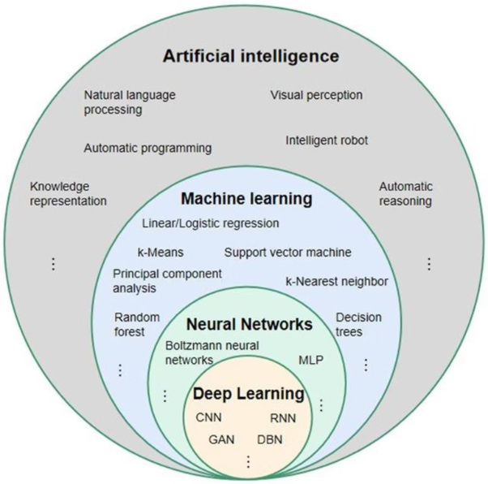
INTRODUCTION
Evolution of Stock Forecasting using AI Models
Traditional Statistical Models
Modern Deep Learning Approaches
Models like ARIMA, GARCH, and other econometric methods:
Recurrent Neural Networks (RNNs): Early deep learning models for sequential data, but often face vanishing/exploding gradient problems over long sequences.
Primarily effective for identifying and forecasting linear patterns in time series data.
Often struggle with the inherent volatility, non-linearity, and complex, dynamic nature of financial markets.
Long Short-Term Memory (LSTMs): An advanced type of RNN specifically
Limited in their ability to capture long-term temporal dependencies and intricate relationships within the data.
Transformers: Revolutionized sequential data processing with self-attention mechanisms,

Slide 4

The Problem:
Challenge in Stock Market Prediction
Why is it difficult to predict the stock market? Here are some reasons:
Stock market prediction is inherently complex, volatile and chaotic in nature.
Random investor sentiments,
Global Economic changes
Traditional ML models (ARIMA, GARCH) all struggle with Acurate Prediction.
These elements constantly changing, making it hard to forecast movements accurately.

Slide 5




The Solution:
Aim and Objectives
This project aims to develop an intelligent stock forecasting system leveraging advanced deep learning models to provide accurate multi-stock predictions and real-time analysis.
Enhance Prediction Accuracy
Compare Model Performance
Significantly improve the accuracy of stock price predictions over traditional methods by utilizing sophisticated deep learning architectures like BiLSTM and Transformer models.
Rigorously evaluate and compare the performance of BiLSTM and Transformer models to identify the most effective architecture for multi-stock forecasting.
Visualize Forecasts & Insights
Enable Real-Time Analysis
Develop intuitive and interactive visualizations for predicted stock movements and key market insights to facilitate informed decision-making.
Implement capabilities for real-time stock data processing and forecasting to support dynamic market analysis and timely investment strategies.

Slide 6



Scope of the Study
This project's scope is defined by the following key areas:
Historical Stock Data
Technical Indicators Integration
Advanced Deep Learning Models
Utilizing comprehensive historical market data from selected major tech companies: AAPL (Apple Inc.), TSLA (Tesla Inc.), and GOOGL (Alphabet Inc.).
Incorporating various technical indicators (e.g., Moving Averages, RSI, MACD) as features to enrich the dataset and capture relevant market trends.
Implementing and evaluating sophisticated deep learning architectures, specifically Bi-directional Long Short-Term Memory (BiLSTM) networks and Transformer models, for multi-stock forecasting.

Slide 7






Methodology:
Data Science Workflow - from Data to Prediction
Our methodology follows that of the Data science and machine learning pipeline
Based on this methodology, We trained two deep learning models (A Baseline model and an Advance Model) on three stock data and deploy the best performing model base on evaluation
Each model training follows the same workflow
Data Ingestion
1
2
Data Preprocessing
Collecting historical market data.
Cleaning, normalizing, and feature engineering, sliding window processing
Model Deployment
6
3
Model Training
streamlit(Price forecast)
BiLSTM & Transformer architectures.
Model Evaluation
Prediction
Metrics(MAE, MSE)
5
4
Generating multi-stock movement forecasts.

Slide 8
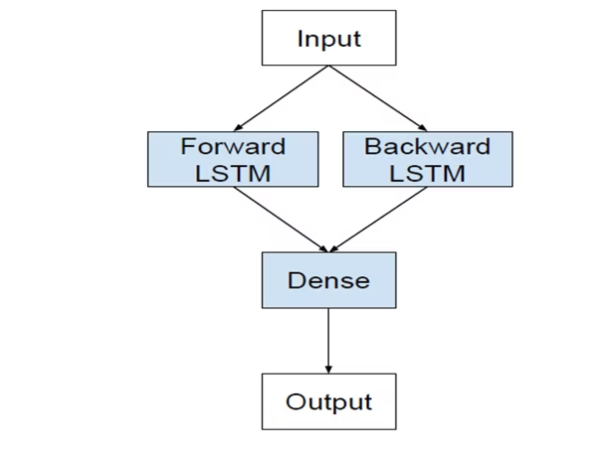
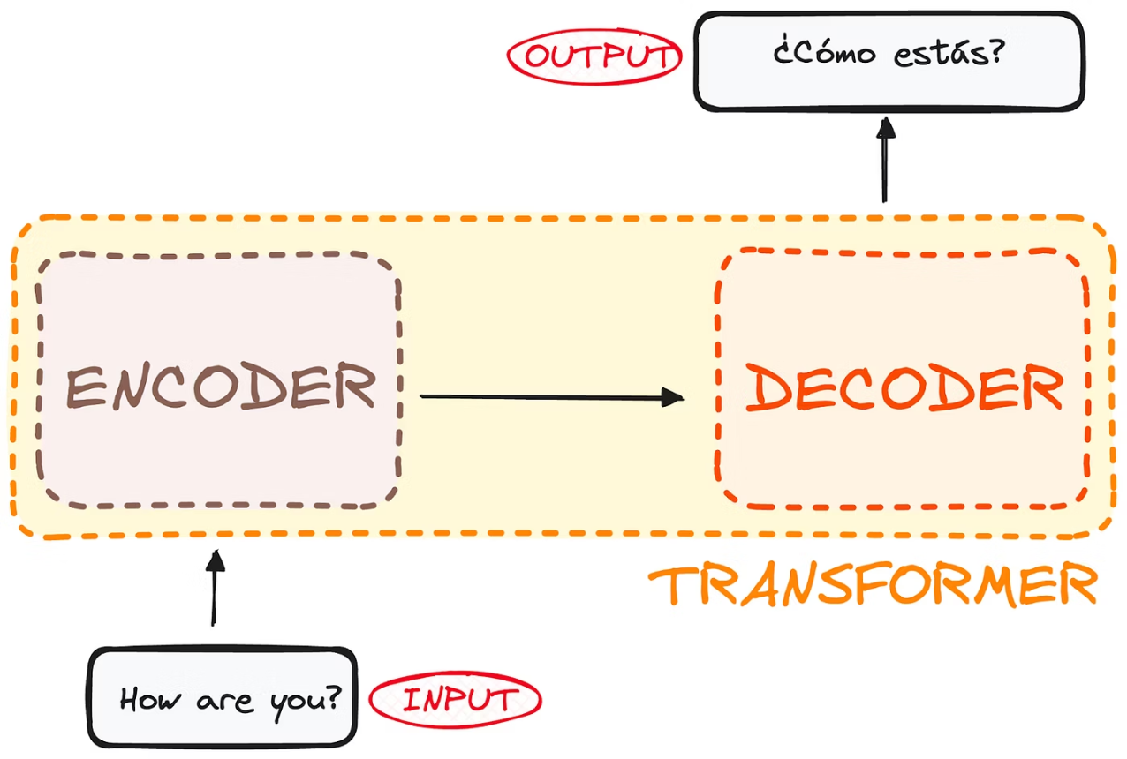
Models Architecture Overview
BI-LSTM (Baseline) VS TRANSFORMER (Advance)
Bilstm is a type of RNN
Uses self-attention to analyze data
It process data sequentially in two directions
Handles long-range dependencies more effectively
its great for time series (stock) data
More scalable and powerful

Slide 9
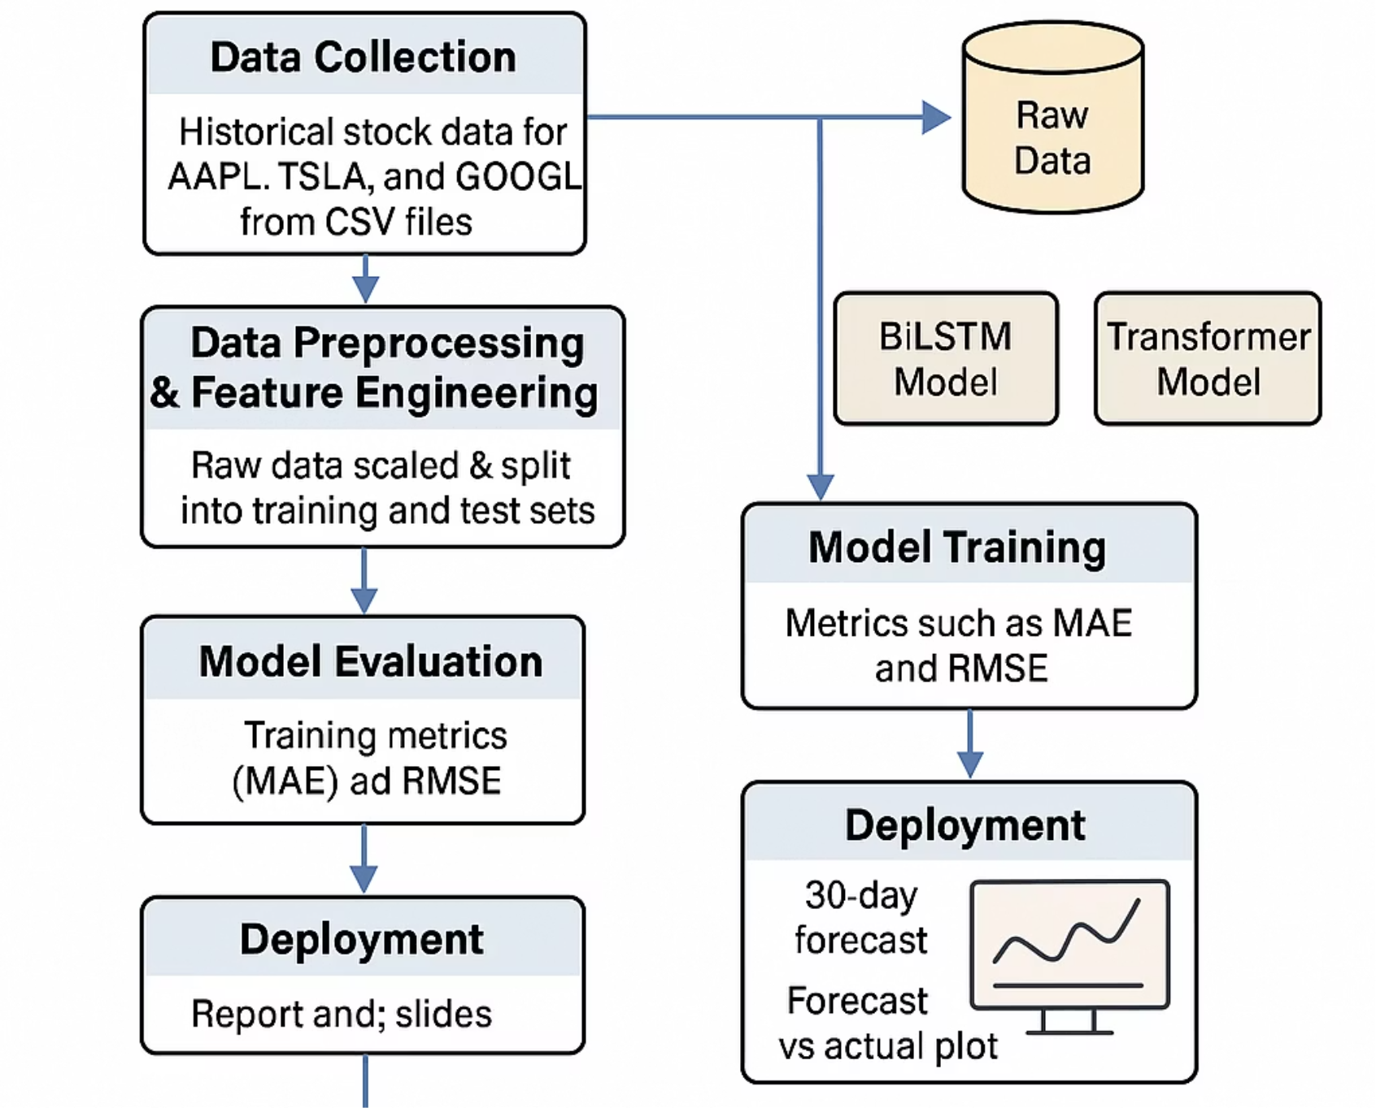
The Implementation:
Model Workflows
Our deep learning solution was meticulously crafted using a robust stack of tools and cutting-edge model architectures, culminating in an accessible real-time analysis platform.

Slide 10
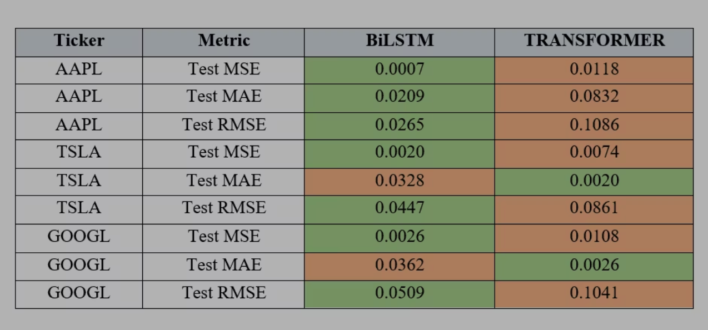
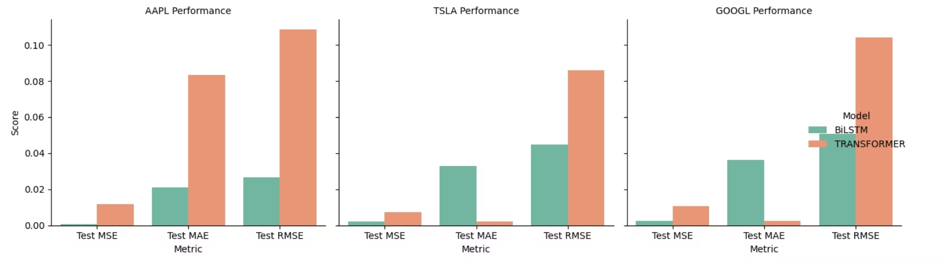
Result Analysis:
Base-Line Model vs Advance Model
How did we know that our model has performed well? We use three evaluation metrics to justify each model performance
MAE - · Measures the average absolute difference between predicted and actual values. It gives an idea of how close predictions are to actual outcomes
MSE- · Measures the average squared differences between predicted and actual values. It penalizes large errors more than MAE.
Directional Accuracy
High MSE/MAE value means poor perfomance
Green Values means good scores
BILSTM consistently shows good performance across all stock data
we choose and deploy BI-LSTM over Transformer

Slide 11
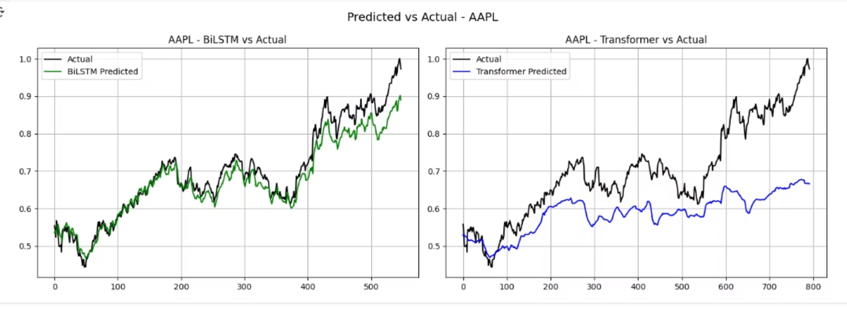
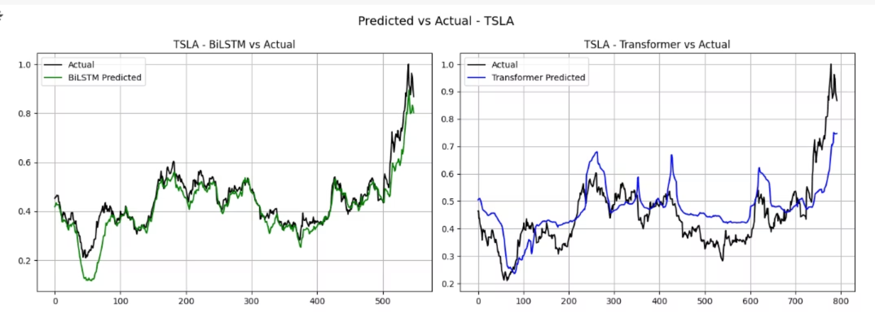
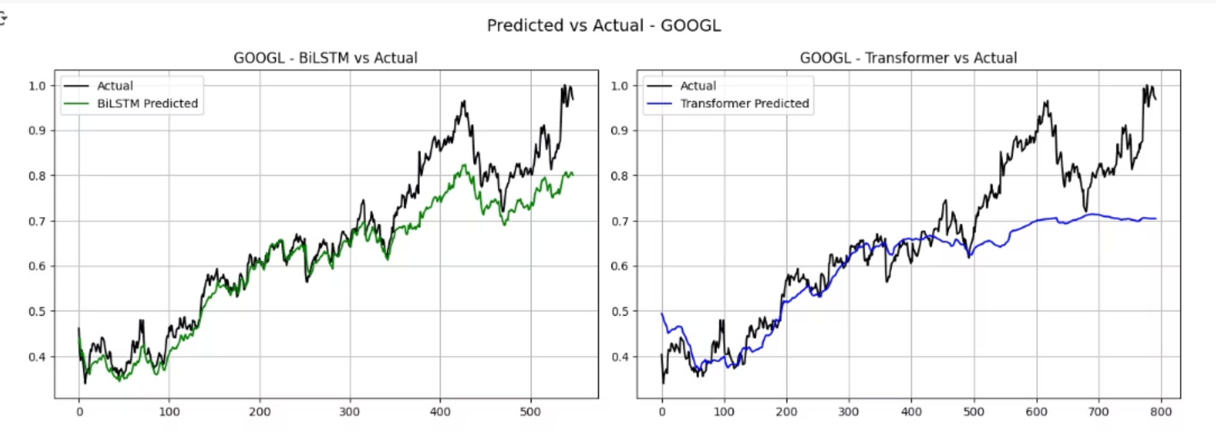
Directional Accuracy
BILSTM outperform Transformer on all Stock Data

Slide 12
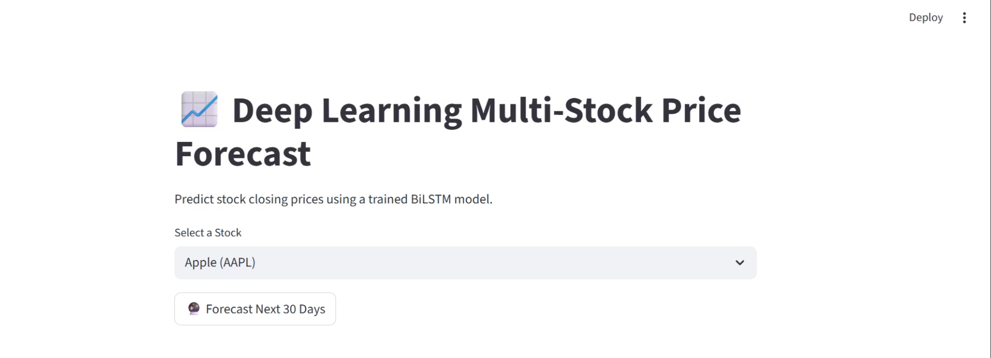
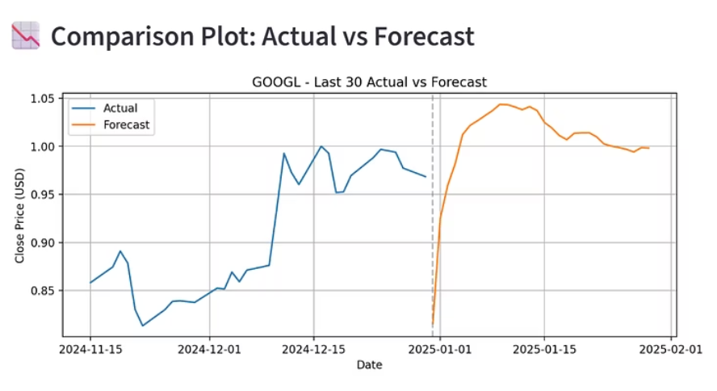
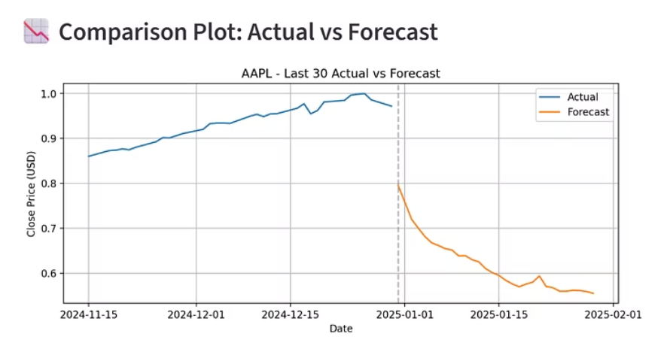
Model Deployment
Real-Time Forecasting App
Our interactive Streamlit application provides users with real-time stock forecasting capabilities, allowing for dynamic analysis and informed decision-making based on the deep learning model's predictions.
Users can input desired stock tickers and forecast horizons, instantly generating predictions and visualizing performance against historical data, offering unparalleled insights into market trends.

Slide 13



Conclusion:
Key Takeaways & Recommendations
Our project successfully developed and evaluated a deep learning solution for multi-stock forecasting, delivering critical insights and paving the way for future advancements.
Superior Accuracy
Real-Time Insights
Future Development
The BIlstm model demonstrated higher predictive accuracy (lower MAE/RMSE) compared to Transformer for multi-stock forecasting.
The developed Streamlit application enables interactive, real-time stock prediction and analysis for users.
Fine-tune Transformer model
Add Transformer to Streamlit Interface
Deploy both model in cloud environment

Slide 14
Thank you for listening.
Questions and feedback are welcome.

